Slide 1
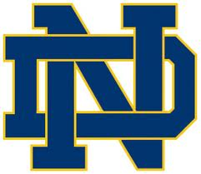
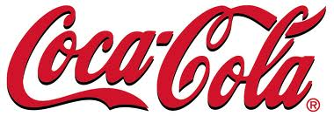
University of Notre Dame’s Sponsorship Proposal
Ryan Suter
₊

Slide 2
Our Goal
The University of Notre Dame wants to enhance a relationship with Coca-Cola Enterprises and Notre Dame football. Through our partnership we feel that both corporations will thrive.

Slide 3
Overview of the Deal
3-year contract
Sponsor 18 home games over three years
Estimate cost of whole deal 3 million
Promotional rights to every home game
Rights to promotions in tailgating/community exposure
Merchandise rights
In/Out of stadium naming rights

Slide 4
Reasons to Sponsor Notre Dame Football
Notre Dame is one of the most powerful and recognizable brands in college athletics
National audience
Opportunity to associate with a prestigious university
23rd best tailgate town in the country (bleacherreport.com)
Game in Ireland creates opportunity for overseas exposure

Slide 5
Location and Exposure
Location for Notre Dame is in South Bend, IN
Total exposure can be up to 15 million people just through television.
With home games that number can increase by over 80,000 more people (capacity of stadium+taligating)

Slide 6
Length of Agreement
We would like Coke to enter a multiple year deal
Coke would sponsor for 3 years with the opportunity to revoke sponsorship or renegotiate a new contract
Why three years?
NBC has sponsorship for the next 3 years and we would like a chance to make another T.V. deal before negotiating with other sponsors

Slide 7
Community Impact
Bringing in revenue
If Coke can promote, it can help the fan experience at the games in South Bend
If Coke can bring more fans to South Bend more people have the opportunity to spend money before and after the game throughout the city.
Creating a home town image
When you think of Notre Dame you think of Coke

Slide 8
Benefits for Coca-Cola
Market-Driven Objectives
Drive retail traffic
Enhance company image
Trade Networking Objectives
Pass-through rights gives Coca-Cola the ability to transfer sponsorship assets to other Notre Dame sponsors.

Slide 9
Benefits for Coca-Cola
Hospitality Objectives
Entertain Clients
Suite availability to discuss business with future clients
Entertain Coca-Cola employees
Cause-Related Objectives
Coca-Cola will be associated with an institution that strives to develop the minds of young adults in preparation for the future.

Slide 10
Strategic Fit
OBJECTIVE:
Target Market: Notre Dame fans around the Nation.
Very loyal fan base with Coca-Cola & ND
Coca-Cola plant located in South Bend gives the brand the “hometown” image

Slide 11
Media Exposure
Notre Dame is the only team to have all games broadcast nationally on the radio.
Every game averages up to 15 million people watch their games through TV.
When at home, the capacity of fans is roughly 81,000.
Without a JumboTron, two modest scoreboards adds a more traditional feel.
We engaged with Twitter, and Facebook to try and gain more fans.
Notre Dame currently has roughly 45,000 followers on Twitter, and Facebook has close to 70,000 people talking about the school.
Radio rights are currently held by IMG Sports, who began a 10 yr. deal with them in 2008.
As far as commercials go, we would like to incorporate a thirty-second ad on television during three home games of Coke’s choice. We aimed to do so by launching them a month prior to opening game day, which is August 31, 2013 for next season.
By doing this, it’s a way to gain last minute potential viewers of Notre Dame.

Slide 12
Exclusivity
If Coca-Cola sponsors Notre Dame football they will be the exclusive suppliers of…
Water, soft drinks, and sports drinks
Notre Dame will be off limits to all Pepsi products
To protect Coca-Cola from ambush marketing products such as Pepsi will not be allowed on campus
Ushers will be stationed to ensure no Pepsi products from entering the stadium.

Slide 13
Sponsorship will include
Six Notre Dame home football games
All press conferences in relation with the football program
Coca-Cola images on backdrop guarantees brand media exposure
Pep Rallies
Coca-Cola product giveaways
Coca-Cola sponsored mini games
Annual spring Blue and Gold game
Advertisements throughout the South Bend area including billboards, TV airtime, and signage in Notre Dame Stadium.
There will also be other smaller local sponsors like South Bend Chocolate Company, Gates Toyota, and Memorial Hospital of South Bend…ect,

Slide 14
Sponsorship Inventory
Inventory | Official Sponsor (Includes Gameday and Title) $1,000,000 (per year) | Title Sponsor (Includes Gameday) $500,000 (per year) | Gameday Sponsor $250,000 (per year)
Soft drink cups | All concessions | All concessions | All concessions
Tailgate Town($60,000) | Tents and booths | Tents and booths inside only | N/A
Tickets($30,000) | Logo on ticket | N/A | N/A
Billboards($20,000) | 2 Billboards | 0 Billboard | 0 Billboards
Interior Signage ($2,500-$5,000) | Press box signage | 10 in concourse areas | Concession stand signs
Scoreboard Logo($10,000) | Only with official | N/A | N/A
Programs($5) | Cover page, and 1 full page add | 1 full page ad | 2 small advertisements throughout program
Commercial($228,000) | 3 30-second commercials | Return from timeout field overview | N/A
Radio($6,000) | 6 twenty second commercials (radio) | 2 ten second commercials (radio) | Verbal plugins
Press Conference($50,000) | Logo on back drop | Logo on back drop | N/A
Pep Rallies | 500 T-shirts to attendees | Concessions with Coke products | Signs in community to advertise
Blue and Gold Game ($10,000) | Logo on scoreboards, Game programs, and tickets | Verbal plugins | N/A

Slide 15
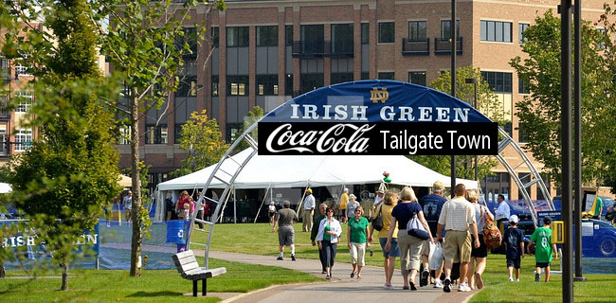
Activation: Tailgate Town
The Irish Green “Coca-Cola Tailgate Town”
Game Day event for EVERYONE
Free Giveaways (small Coca-Cola bottles, T-shirts, Etc.), games for kids, AND… a big screen T.V. to watch the game itself.

Slide 16
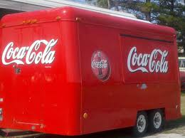
Activation: Coca-Cola Trailers
Four concession trailers set outside each gate of ND stadium :
Gate A (Dan Devine Gate)
Gate B (Ara Parseghian Gate)
Gate C (Frank Leahy Gate)
Gate D (Lou Holtz Gate)

Slide 17
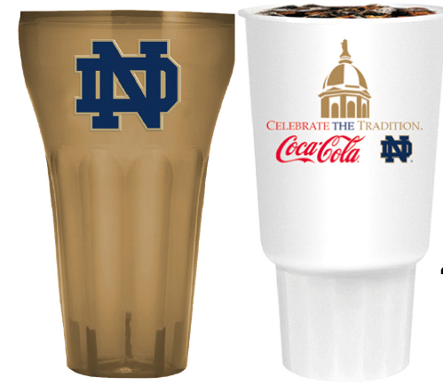
Activation: Promotional Packaging
40-oz. Souvenir Cup
12-Pack Promotional Packaging

Slide 18
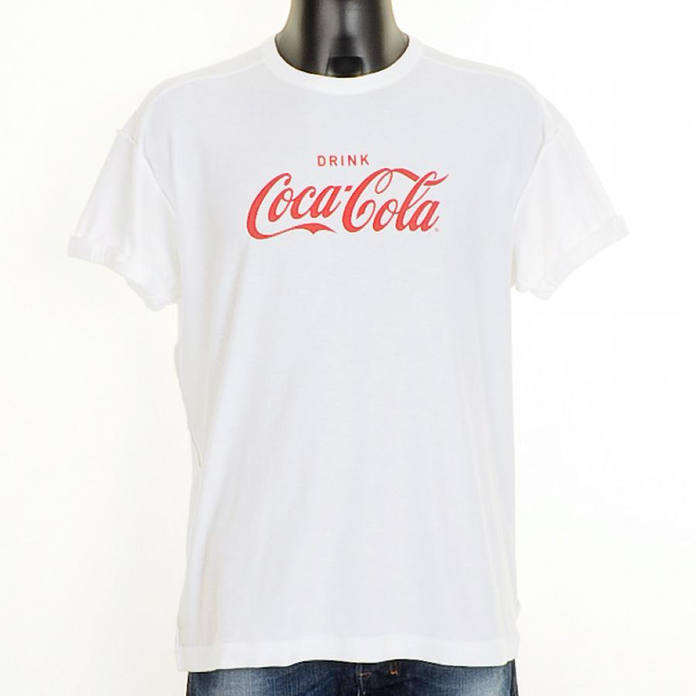
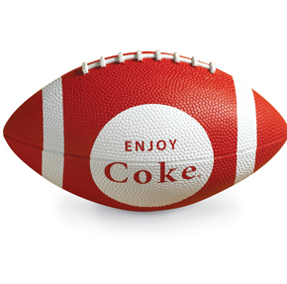
Activation: Promotional Giveaways
Free T-shirts for the first 1,000 tailgaters at Coca- Cola Tailgate Town
Free T-shirts for the first 1,000 fans every home game
1,000 inflatable footballs passed out throughout the parking lots during tailgating for every home game

Slide 19
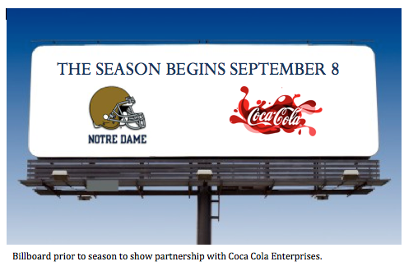
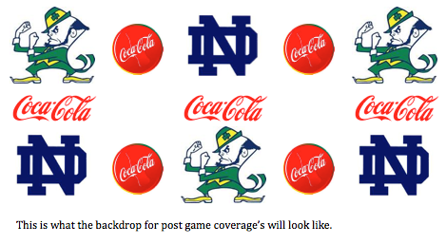
Activation: Signage
Billboards coming into South Bend
Press conference backdrop

Slide 20
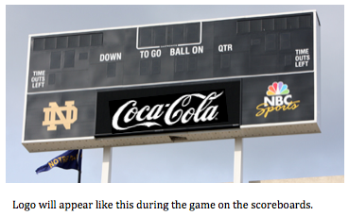
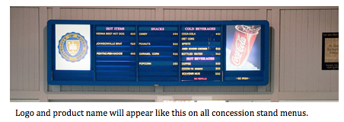
Activation: Signage
14 Menus and signs within Notre Dame Stadium
2 Logo placements on both scoreboards North and South sides of end zones.

Slide 21
Fulfillment
2 representatives (8 total) at each Coca- Cola trailer
Notre Dame volunteers report to each trailer/ concession at their assigned locations
Total of 50-75 assigned volunteers
On-site exposure
Signage (14 in stadium) and scoreboards (2 either side of field)
Off-site exposure
Local stores advertise Notre Dame with Coca-Cola products.

Slide 22
Evaluation and Measurement
There are several ways we can measure impact of the sponsorship:
Sending surveys home within the community, allows us to test product recognition
Coca-Cola tailgate towns allow people to talk and discuss feedback of previous or future games.
Surveys & questionnaires are used to determine how affective Coca-Cola reaches consumers.
Coupon redemption
This will show us the number of people take note of coupons printed on the back of tickets.
Also it will project how we are doing as far as offering incentives
Social Media alerts
How many people respond to the incentives via social media?
Specific alerts via Twitter about market share measurements help know what’s going on as far as the school, or, athletics are doing as far as injuries, and delays go.

Slide 23
Sponsorship and their Markets
Notre Dame and Coca- Cola have no demographic limitations. Their audience attracts all age groups.
Lifestyle Fit:
You can’t have Notre Dame Football without Coca- Cola.

Slide 24
Contractual Terms
As the University of Notre Dame, we wish to expand our contracts to you. The contract will include the following:
NBC has aired all football games since 1991. Notre Dame signed this agreement for $38 million for 5 years
In June, 2008, NBC signed an extension contract covering from 2011 to 2015. According to the school, a portion of the television revenue goes toward academic scholarships
For nearly 20 years, the partnership with NBC has been valuable for both the network and University. It’s great to know future students will benefit from this partnership in the form of a need-based scholarships
All Renewal options are available at the end of each contract if chosen to do so

Slide 25
Estimated Annual Revenue
We estimate that it will cost approximately $600,000 per season to accomplish this Coca-Cola Notre Dame Image.
This will cost Coca-Cola $1 Million which gives Notre Dame a profit of approximately $400,000 every season.

Slide 26
Closing Remarks
In conclusion, Notre Dame football is excited to form a relationship with Coca-Cola Enterprises. With media exposure, fan promotions, and new combined Coca-Cola and Notre Dame products we feel as if Coca-Cola can become a household name in the Notre Dame community.

